Slide 1
Salesforce Practice
by Kloudrac

Slide 2
Thank you
Thank you for giving us an Opportunity to present and talk about Kloudrac capabilities
We have successfully delivered “N” no of Projects all over the globe. Our Team constitutes of Certified Salesforce Consultants, Architects, Developers and Quality Analysts.
We assure you for the successful implementation and timely delivery of the Project.
Looking forward for the Long Term Association.

Slide 3
About Kloudrac
7+
Years in the Industry
100+
Clients worldwide
200+
Developers, Architects, UI/UX and BA/PMs
15
IP Solutions
100+ Sales Cloud
35+ Service
20+ Pardot
15+ Marketing
Kloudrac
Labs
India
Noida Bangalore, Mumbai
Lifecycle Services
Architecture
Consulting
Implementation
Support
IP development
Reusability
App Development
Adoption Techniques
Mobile & UX
USA
SF, California
Miami, Florida

Slide 4
Salesforce Services
Business Consulting
Technology Planning
Product Evaluation
End user & Technical Training
Implementation
Offshore Implementation & Development
Deployment
Support
Force.com Development
AppExchange Product Development
Security Consulting
Optimization and Review

Slide 5
Client Wins : Sales Cloud

Slide 6
Client Wins : Service Cloud

Slide 7
Client Wins : Marketing Cloud

Slide 10
Integration Expertise
Integrations with the 3rd party Systems
Middleware used for the Integrations
SAP
Boomi
Oracle
NetSuite
Mulesoft
Microsoft AX
AWS
Salesforce Connect
Jira

Slide 11
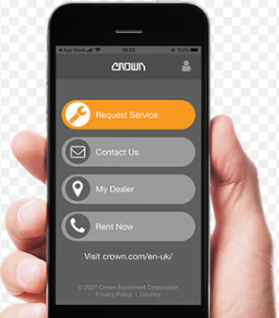
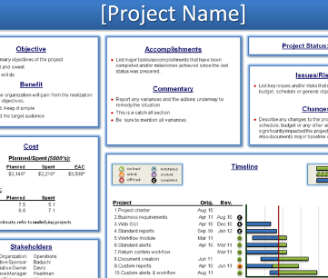
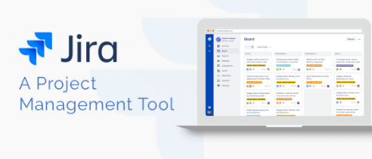
Project Management Best Practices
Agile Methodology
We use the Service Request App for the Post Implementation support
Weekly Project updates to the customer about the Progress
We are using Jira for the Project Management

Slide 12
Thank You
Thank You

